Slide 1

The influence of various factors on the spread of COVID-19
By Helena Fedorenko, Xing Ying Chen and Brecht Nys

Slide 2



The factors that we have considered…
Government Response
Vaccination Rate
Air Quality
Extended periods of school- and workplace closing, and international travel restrictions, have lead to a lower spread of COVID-19 cases.
Higher vaccination rates result in lower reproduction rates and lower death rates.
Areas with poor air quality have shown higher rates of COVID-19 cases.

Slide 3
Factor: Government Response
Hypothesis: Extended periods of school- and workplace closing, and international travel restrictions, have lead to a lower spread of COVID-19 cases.
Dataset:
Data on Covid-19 Confirmed Cases Worldwide, includes 181 countries. (January 2020 - March 2020)
Stringency index data by country, which records the strictness of ‘lockdown style’.
Variables:
Growth of Covid-19 Cases by country: numbers of confirmed cases over first 3 months of pandemic.
Stringency index : increase in stringency index over first 3 months of pandemic.
Relationship between variables: perform linear regression analysis. Confirmed cases vs stringency index.

Slide 4
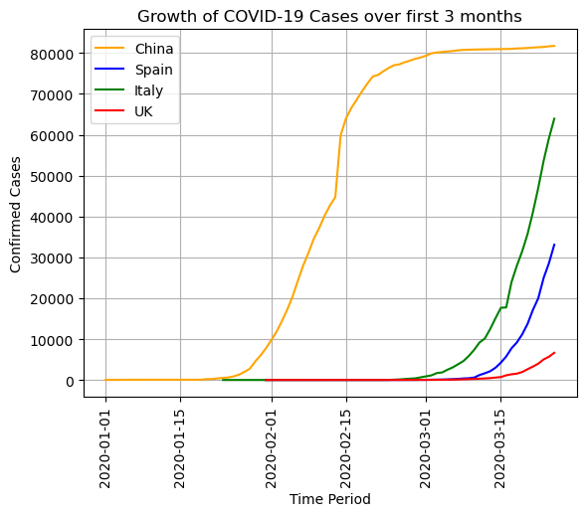
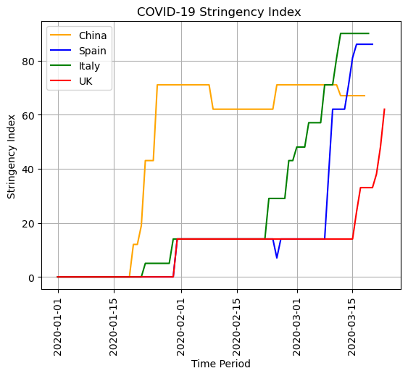
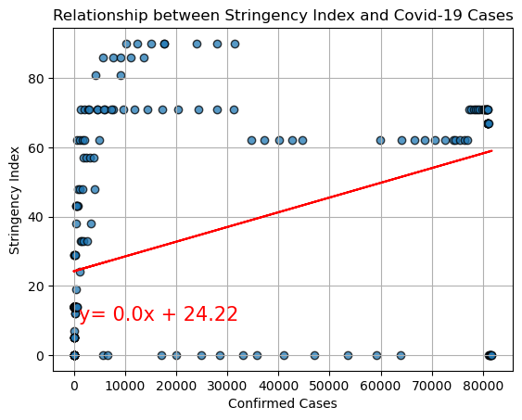
Factor: Government Response
Hypothesis: Extended periods of school- and workplace closing, and international travel restrictions, have lead to a lower spread of COVID-19 cases.
Outcome
We performed a data visualization analysis in order to understand better, if the government responded to Covid-19 pandemic and how quickly they did.
We have analyzed four different countries.
1st line graph:
Covid-19 Cases started to rise beginning of January in China, then Italy, UK and Spain.
2nd line graph:
Government response on the growth of Covid-19 cases. Which measures by Stringency index.
The index records the strictness of ‘lockdown style’ policies that primarily restrict people’s behavior.
It is calculated by using nine metrics: school closures; workplace closures; cancellation of public events; restrictions on public gatherings; closures of public transport; stay-at-home requirements; public information campaigns; restrictions on internal movements; and international travel controls.
3rd line graph:
by performing linear regression analysis, we investigated relationship between Government Response and growth of Covid-19 cases.
r - value = 0.43
In this case, a correlation coefficient of 0.43 suggests a moderate positive linear relationship between the two variables. Which means as Covid-19 cases increase over time, the stringency index tends to increase as well.

Slide 5
Factor: Vaccination Rate
Hypothesis: Higher vaccination rates result in lower reproduction rates and lower death rates.
Dataset
Data on COVID-19 cases and vaccination rates for 236 countries from Feb-2020 until Feb-2023;
Country name mapped to continent using RESTCOUNTRY API
Process
Define variables:
Reproduction rate (“RR”): the average number of people that one infected person will pass the disease on;
Vaccination rate (“VR”): proportion of country population that has received at least one vaccination;
Fully vaccinated rate (“FVR”): proportion of country population that has received both vaccination;
Death rate (“DR”): proportion of infected people that died.
Analysis:
Part 1: Influence of vaccination rate on reproduction rate and death rate;
Part 2: Visible differences between high or low levels of vaccination rate;
Part 3: Regional discrepancies between Europe, Asia and Americas.

Slide 6
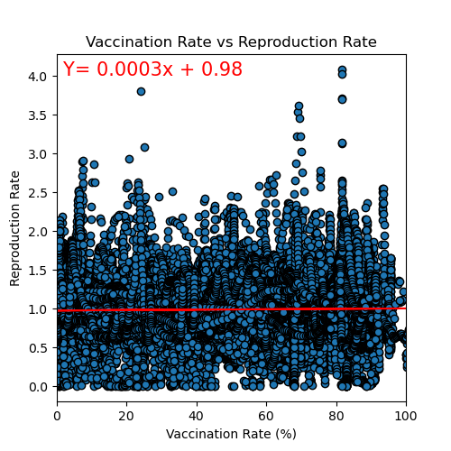
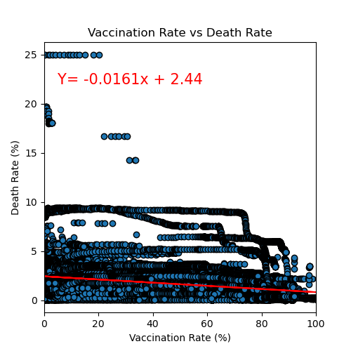
Factor: Vaccination Rate
Part 1: Influence of vaccination rate on reproduction rate and death rate
Outcome
We performed a linear regression analysis to investigate the relationship between:
Vaccination rate and Reproduction rate;
Vaccination rate and Death rate.
Vaccination rate and Reproduction rate:
We found no significant association;
The slope of the regression line was 0.0003 (0.0005 for FVR);
R-value was only 2.5% (5.1% for FVR), indicating a weak correlation.
Vaccination rate and Death rate:
We observed a moderate to low association;
The slope of the regression line was -0.016 (-0.0178 for FVR), suggesting that higher vaccination rates were associated with lower death rates.
The R-value was -32.4% (-35.9% for FVR), indicating a negative correlation.

Slide 7
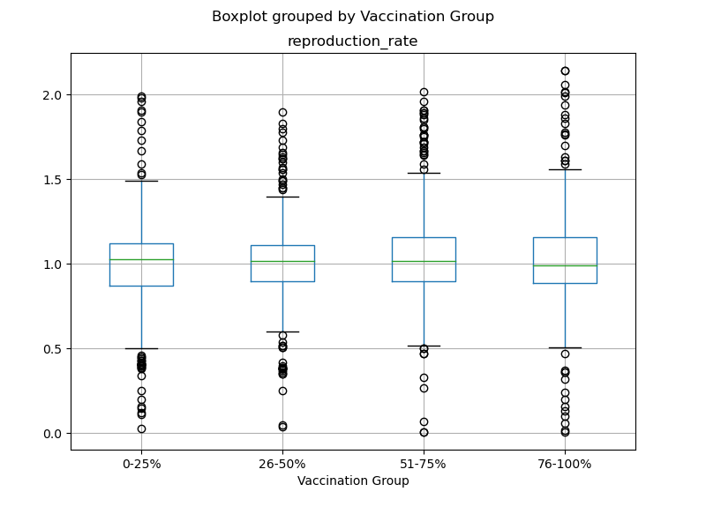
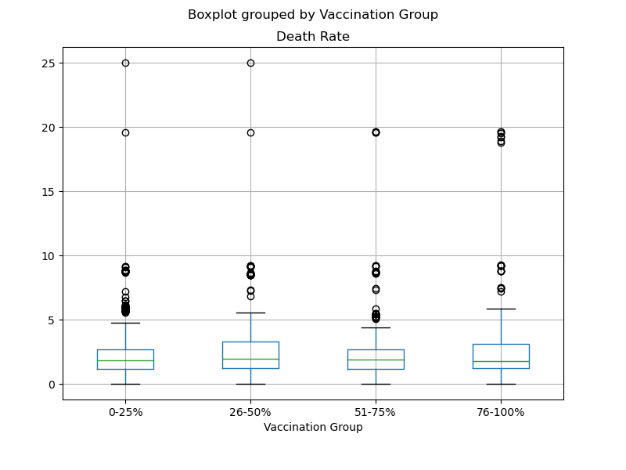
Factor: Vaccination Rate
Part 2: Visible differences between high or low levels of vaccination rate
Outcome
We investigated whether there were discernible differences in either Reproduction- or Death rates between high and low levels of Vaccination rate.
We found no significant contrast between the level of Vaccination rate and either the Reproduction Rate or the Death rate.
Therefore, we conclude that level of Vaccination rate alone is not sufficient to predict changes in outcome.

Slide 8
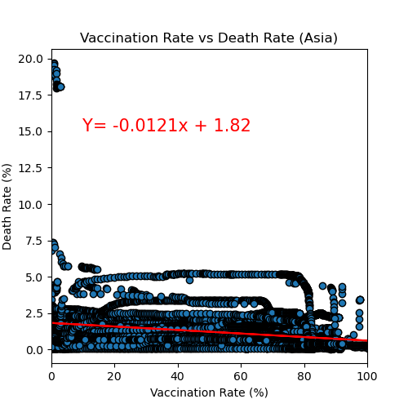
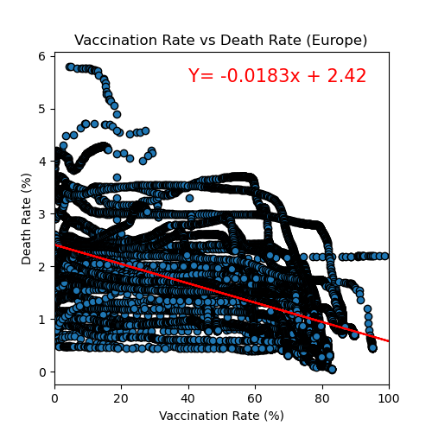
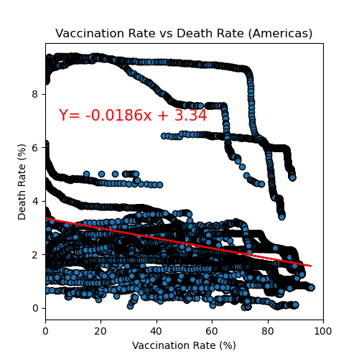
Factor: Vaccination Rate
Part 3: Regional discrepancies between Europe, Asia and Americas
Outcome
We performed a linear regression analyses separately for each continent to explore the relationship between Vaccination rate and Death rate;
In Asia, we found a negative slope of -0.012 and an R-value of -27.6%, indicating a moderate negative correlation between Vaccination rate and Death rate;
In Europe, we observed a steeper negative slope of -0.018 and a stronger negative correlation with an R-value of -56.4%.
In the Americas, we found a similar negative slope of -0.019 and an R-value of -27.8%, indicating a moderate negative correlation between Vaccination rate and Death rate;
Therefore, we conclude that there are some regional disparities in the strength of the association between Vaccination rate and Death rate, with Europe showing the strongest negative correlation.

Slide 9
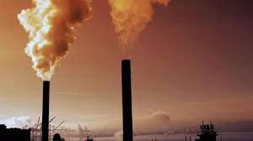
Factor: Air Quality
Hypothesis: Areas with poor air quality have shown higher rates of COVID-19 cases.
Variables:
Pollution Rank by Country: Rank of world most polluted countries
Confirmed Covid Rate: Covid cases divide by country population.
Death Rate: Total number of Covid death cases in each country divided by total confirmed Covid cases.
Recovered Rate: Total number of Covid recovered cases in each country divided by total confirmed Covid Cases in each Country.
Dataset:
Rank of world most polluted countries based on pollution rate from 2018 to 2021
Latest covid data set: accumulated data on all covid cases worldwide (from 2019-2021).

Slide 10
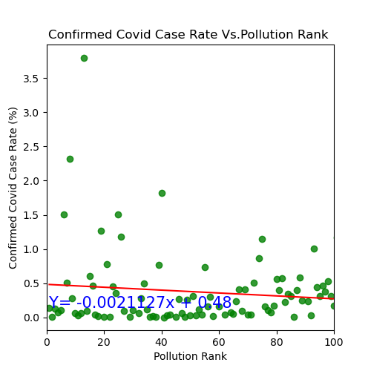
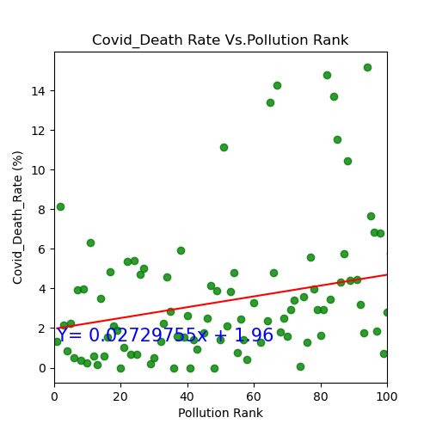
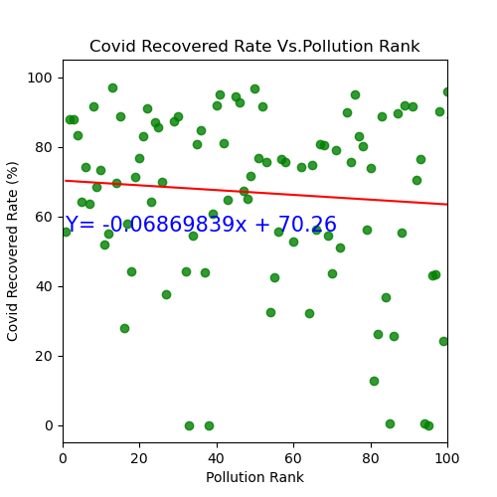
Factor: Air Quality
Hypothesis: Areas with poor air quality have shown higher rates of COVID-19 cases.
Outcome
We performed a linear regression analyses separately for Air pollution ranks vs. confirmed Covid-19 rate; Covid19 death rates; and covid 19 recovery rates:
Air Pollution Rank vs. Confirmed Covid 19 Case Rate:
There is a weak negative correlation between the confirmed COVID-19 case rate and pollution rank. The R-value is negative (-0.130), the slope is (-0.0021127). It means that higher pollution ranks are associated with slightly lower confirmed COVID-19 case rates.
Air Pollution Rank vs. Covid 19 Death Rate:
there is a weak positive correlation between COVID-19 death rate and pollution rank, as the R-value is positive (0.266), the slope is (0.02729755). It means that higher pollution ranks are associated with slightly higher COVID-19 death rates.
Air Pollution Rank vs. Covid 19 Recovered Rate:
there is also a weak negative correlation between COVID-19 recovery rate and pollution rank, as the R-value is negative (-0.086), the slope is (-0.06869839). It means that higher pollution ranks are associated with slightly lower COVID-19 recovery rates.

Slide 11
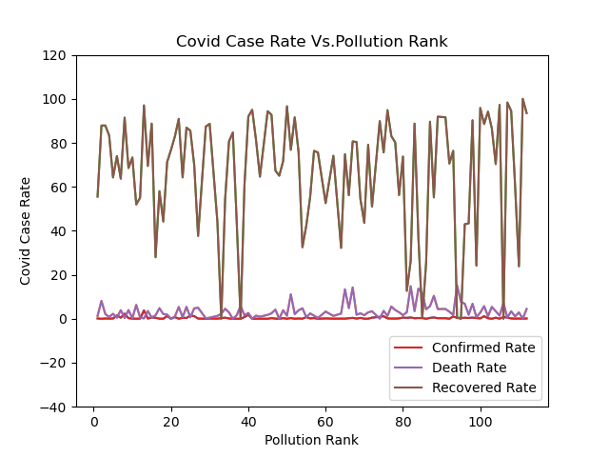
Factor: Air Quality
Hypothesis: Areas with poor air quality have shown higher rates of COVID-19 cases.
Outcome
We also performed a line graph to analyse the relationship between Air pollution and Covid19
Based on the line graph, air pollution doesn’t have a significant effect on Covid case rates.
Improvement
Use a larger sample size
More up to date dataset needed
Include more variables such as population density, demographics or healthcare infrastructure

Slide 12
Any questions?

